Slide 1



Axon Classic Cars Retailers
Sales Presentation
Abhishek Ramesh Shettigar / 12 February 2024

Slide 2

Agenda
Problem Statement
Objective
Process
Solution
Insights
Recommendation

Slide 3
About us
“We breathe life into iconic bikes, scooters, cars, and more, offering a journey through automotive history.”
Axon Company is more than just a classic car retailer; we're passionate curators of automotive history. Founded on the love for timeless design and engineering, we offer a diverse collection of meticulously restored and maintained vehicles that span decades and continents. Whether you're seeking a two-wheeled adventure on a vintage scooter, the open-air freedom of a classic roadster, or the grandeur of a historical train, Axon has something to ignite your passion.

Slide 4
Problem Statement
• Axon's sales data is disorganized and lacks a centralized system.
• The absence of a BI tool hampers data analysis.
• Management struggles to access timely and accurate sales reports.
• The company is unsure to choose a BI tool, leading to uncertainty about tool compatibility and capabilities.

Slide 5

Objectives
Implement a BI solution to help the company to effectively manage sales data
Import the MySQL into Power BI
Clean and transform the data in Power Query
Build interactive dashboards and reports using Power BI, facilitating data understanding for the sales team and management.
Enable real-time access to dashboards and reports, empowering the management to make data-driven decisions.

Slide 6

Tools
SQL
Microsoft Power BI
PowerPoint
Dataset is in MySQL database
We shall use SQL for advanced insights
Load the dataset into Power query for data transformation
Create insights from the transformed dataset
Presenting the insights to stakeholders

Slide 7



Hello there!
Abhishek Ramesh Shettigar
Data analyst

Slide 8
Process
1.
Data Understanding
2.
Data Cleaning and Transformation
3.
Data Modelling
4.
Data Analysis
5.
Gather Insights

Slide 9
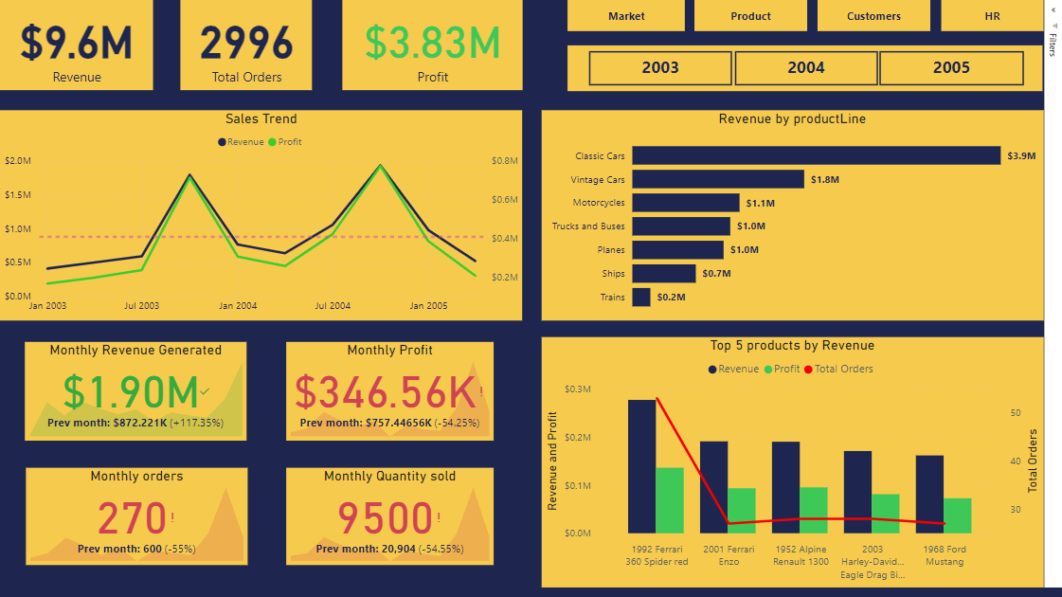

Slide 10
Overview
$ 9.6 M
110
122
Revenue generated by the company
No. of unique products present in the company
Total customers present in our company

Slide 11
1. Customer location
Most of our customers are in USA, Germany and France which consists around 50% of our total customers.
2. Most revenue generating product lines
Classic cars and vintage cars bring almost 60% of our revenue
Insights
3. Best products
The product "1992 Ferrari 360 Spider Red" with 53 orders "1937 Lincoln Berline“ with 27 orders.
4. Top customers
Euro + shipping channel and Mini gifts distributors Ltd. are the best customers in terms of revenue generated
5. Top performing employees
Gerard Hernandez and Lislie Jennings are the best salesperson with $ 1.26 M and $ 1.08 M respectively

Slide 12
Recommendation

Slide 13

Market Expansion
While USA is the most profitable market, we might need to focus on the European markets
Spain, UK and Italy should be our main focus for expansion in the European markets

Slide 14
Product Line Upgrade
Introduce certain upgrades in classic vars and vintage cars categories to ensure more sales

Slide 15
Business relations
Establish good business relations with top performing vendors like 'Classic Metal Creations,' 'Motor City Art Classics,' and 'Carousel DieCast Legends’ to assure the revenue

Slide 16
Recognition Award
Host a recognition award for the best sales employee to assure motivation amongst other sales employee.
If possible, provide a good hike and bonus components to the employee

Slide 17
Thanks for Attending!
LinkedIn profile:- Abhishek Ramesh Shettigar
Medium profile:-Abhishek Ramesh Shettigar
Data Analyst Portfolio:- Abhishek Ramesh Shettigar
Github:- AbhishekDataAnalyst

Slide 18




Reference
Page
1.
Sales Dashboard
https://bit.ly/3HVq62t
2.
SQL Sales Analysis
https://bit.ly/4bB5Alm

